Slide 1
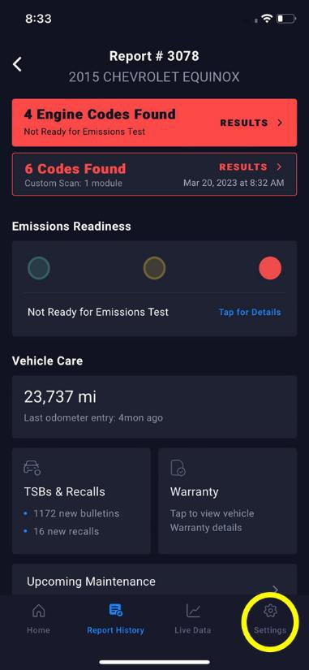
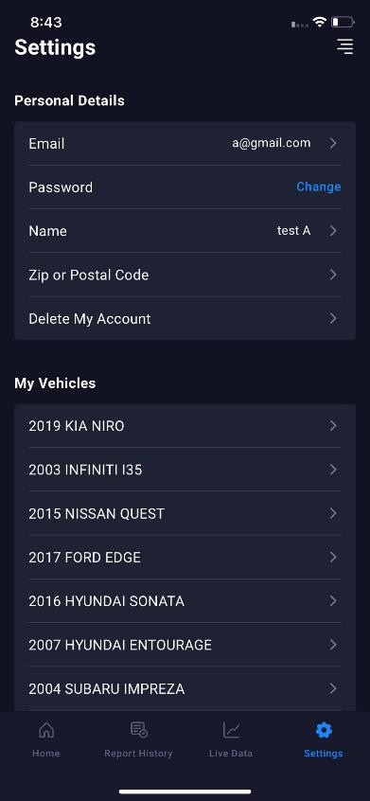
1. Open the RS2 App
By default, opening the app would show the ‘Home’ screen.
2. Select the “Settings” icon at the lower right corner of the screen.

Slide 2
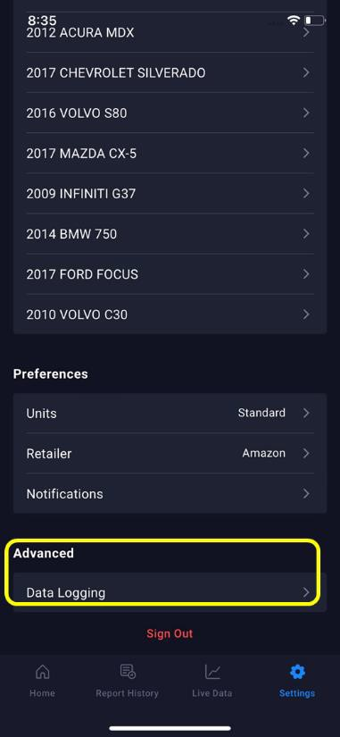
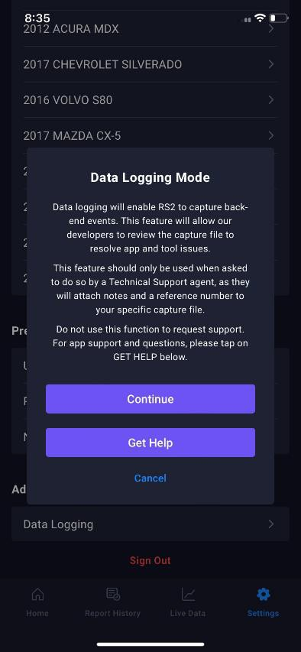
Scroll down to find the ‘Data Logging’ in the Advanced tab.
3. Tap ‘Data Logging’ in the Advanced tab. The Data Logging Mode will display. Select Continue to go to the Report an Issue screen.

Slide 3
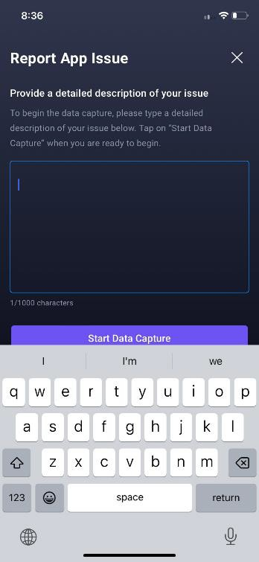
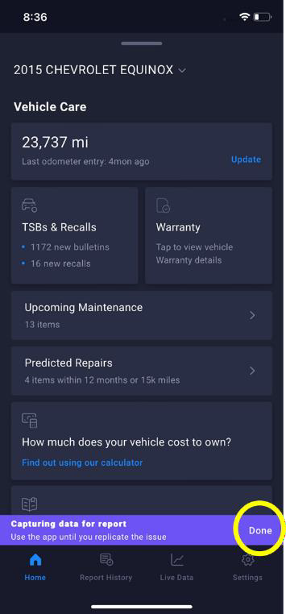
4. You will be prompted to write your issue in a text box. You are given a minimum of 50 characters and a maximum of 1,000 characters for your report.
After you write down your issue, select 'Start Data Capture' to begin replicating the issue in the app.
5. Once you select 'Start Data Capture,' a banner will appear at the bottom of your screen indicating that the app is recording your screen. You may now replicate your issue within the RS2 app.
After you are done replicating the issue, select 'Done' on the right side of the banner.

Slide 4
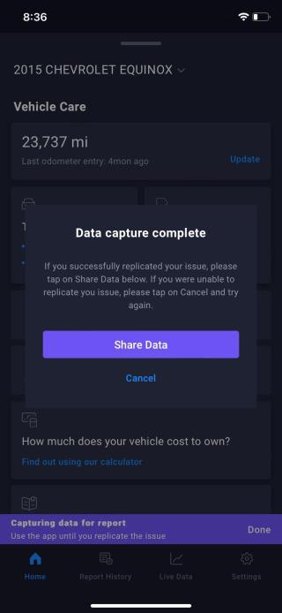
6. After you select 'Done' and are done with replicating the issue, select 'Share Data' to send your issue report to our customer service team.
7. A confirmation email will automatically be sent to your account's email address notifying you that we have received your issue report.
Our customer service team will then review your issue and get back to you shortly.

